Slide 1
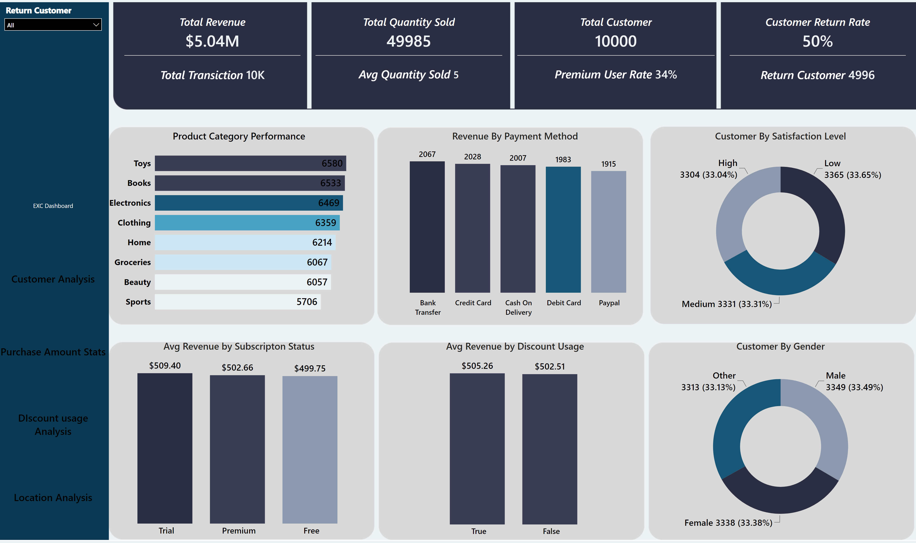
EXC Dashboard
Notes:
cardVisual
No alt text provided
cardVisual
No alt text provided
cardVisual
No alt text provided
cardVisual
No alt text provided
Product Category Performance
No alt text provided
Revenue By Payment Method
No alt text provided
Customer By Satisfaction Level
No alt text provided
Avg Revenue by Subscripton Status
No alt text provided
Avg Revenue by Discount Usage
No alt text provided
Customer By Gender
No alt text provided
pageNavigator
No alt text provided
slicer
No alt text provided

Slide 2
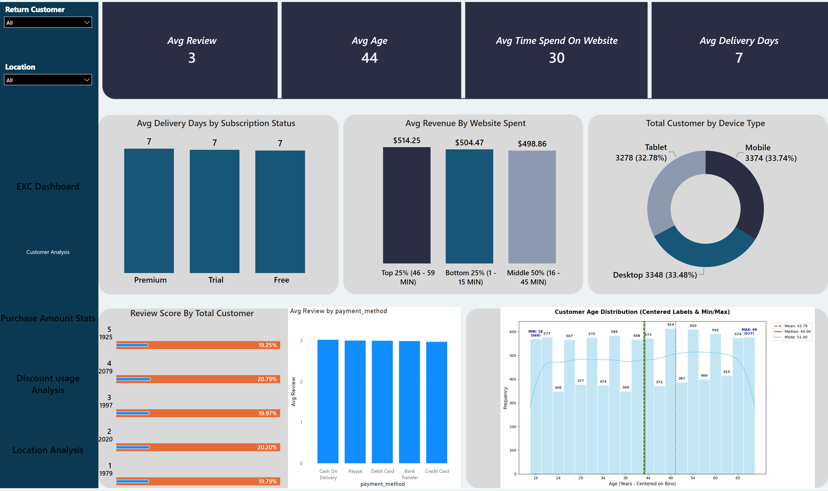
Customer Analysis
Notes:
cardVisual
No alt text provided
cardVisual
No alt text provided
cardVisual
No alt text provided
cardVisual
No alt text provided
Review Score By Total Customer
No alt text provided
Avg Delivery Days by Subscription Status
No alt text provided
Total Customer by Device Type
No alt text provided
Avg Revenue By Website Spent
No alt text provided
clusteredColumnChart
No alt text provided
image
No alt text provided
pageNavigator
No alt text provided
slicer
No alt text provided
slicer
No alt text provided

Slide 3
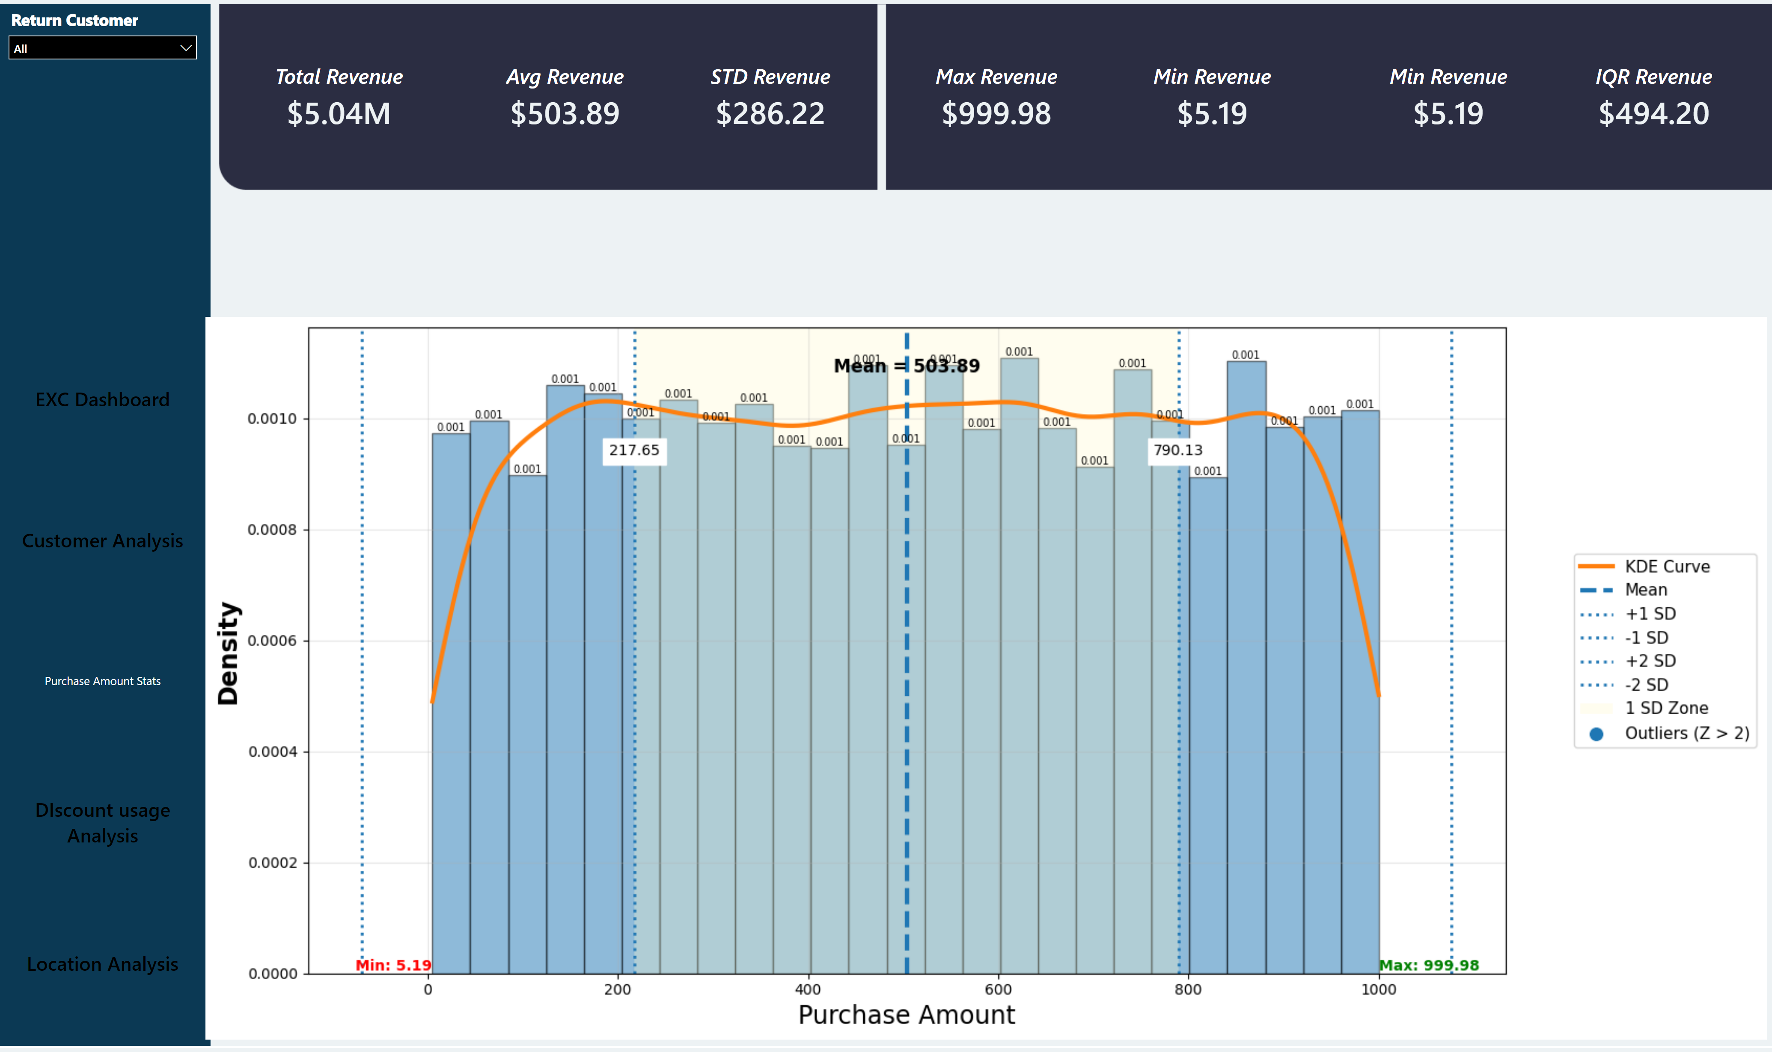
Purchase Amount Stats
Notes:
image
No alt text provided
cardVisual
No alt text provided
cardVisual
No alt text provided
cardVisual
No alt text provided
cardVisual
No alt text provided
cardVisual
No alt text provided
cardVisual
No alt text provided
slicer
No alt text provided
pageNavigator
No alt text provided
cardVisual
No alt text provided

Slide 4
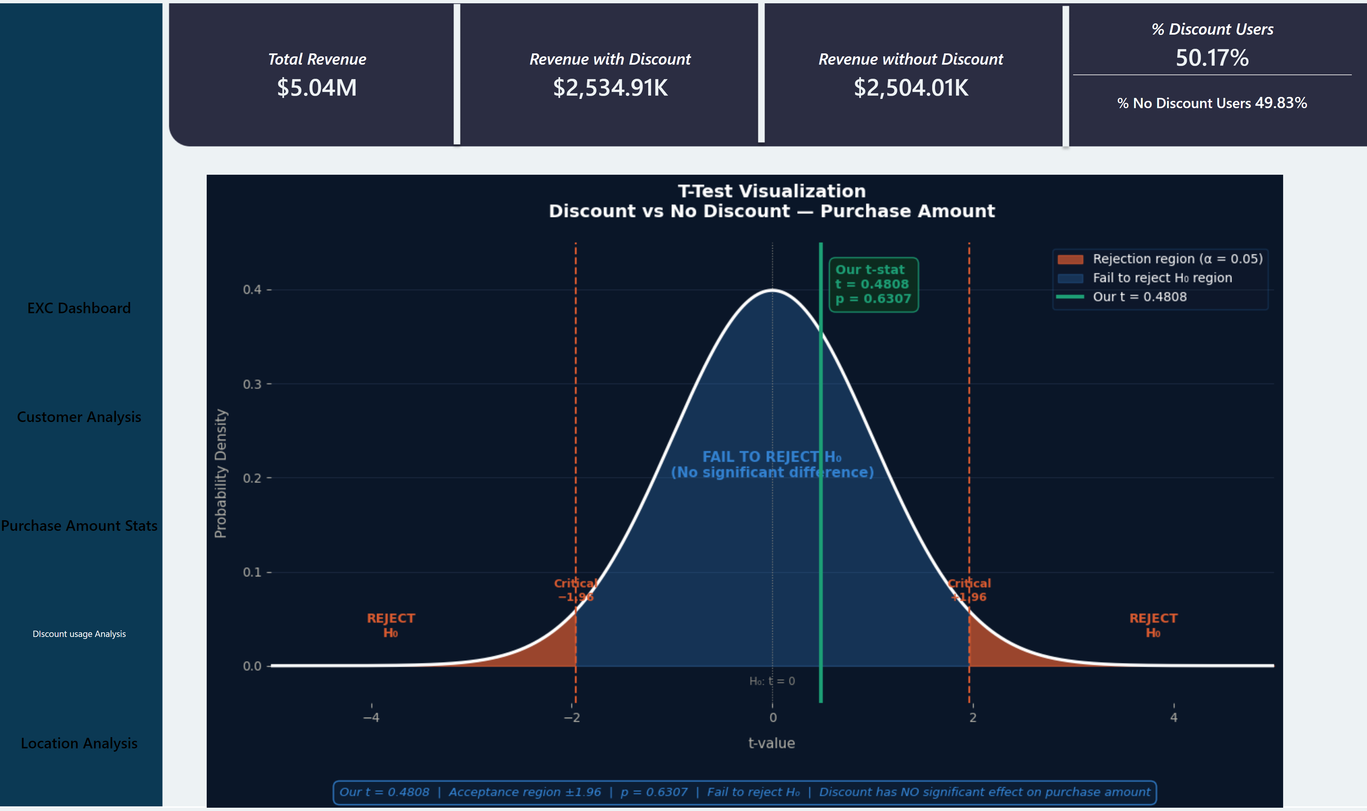
DIscount usage Analysis
Notes:
cardVisual
No alt text provided
cardVisual
No alt text provided
cardVisual
No alt text provided
cardVisual
No alt text provided
image
No alt text provided
pageNavigator
No alt text provided

Slide 5
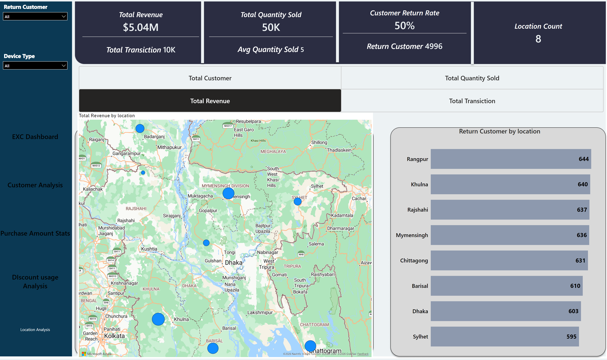
Location Analysis
Notes:
azureMap
No alt text provided
advancedSlicerVisual
No alt text provided
Return Customer by location
No alt text provided
cardVisual
No alt text provided
cardVisual
No alt text provided
cardVisual
No alt text provided
cardVisual
No alt text provided
pageNavigator
No alt text provided
slicer
No alt text provided
slicer
No alt text provided

